Slide 1
Project Name:-ACCIDENT EMERGENCY INTELLIGENCE
Created by :- Darshit dobariya , Deep panseriya
- 170160116022 170160116055
- Information technology

Slide 2
Existing Problem
According to Times of India about 1,46,133 people were killed in road accidents in India in the year 2019.
Unfortunately about 30% of deaths are caused due to delayed ambulance.
This ratio of deaths can be decreased by our device because it will call the ambulance immediately.

Slide 3
work of the project
The system of our project is able to detect the happened accident automatically by itself.
After detecting it will verify if the people present in the particular vehicle are safe or not.
After the verification if the people are not safe the system will automatically call the ambulance.
It will share all the details of the accident including the location using voice call like any other human call.

Slide 4
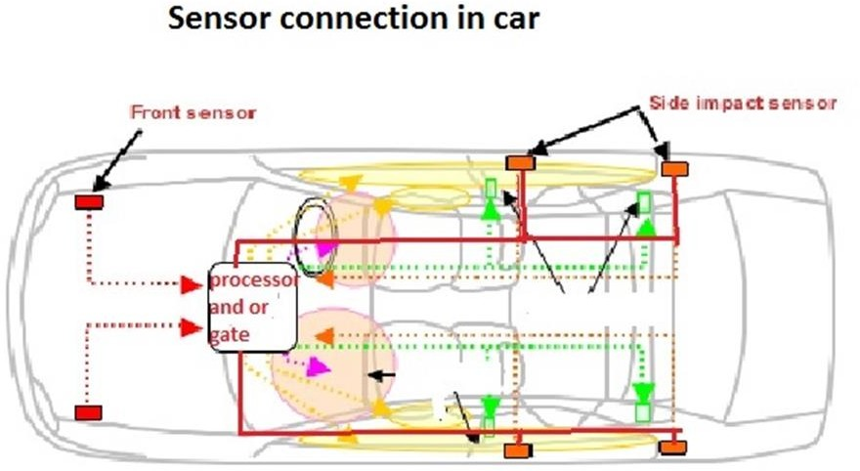
[implementation of shock sensor]

Slide 5
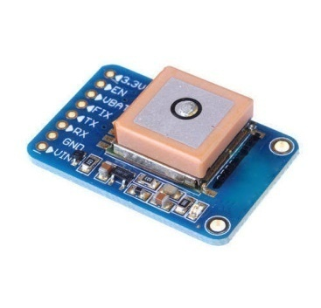
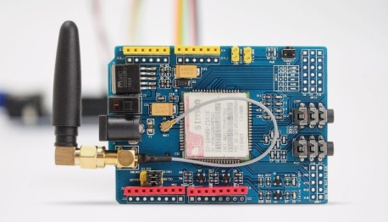
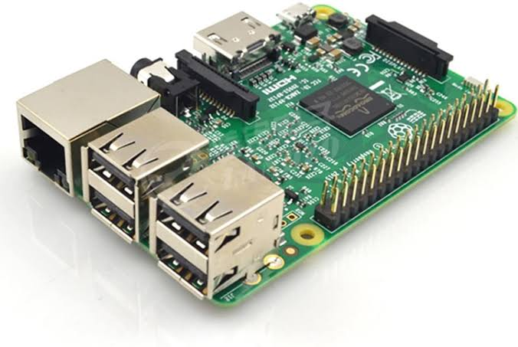

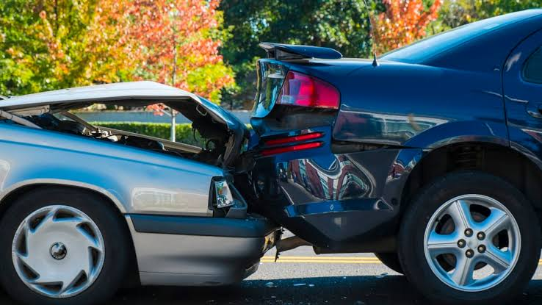
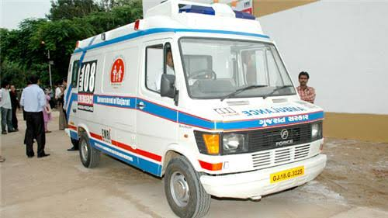
Working of the device
GPS used for
Spot accident
location
GSM Module Used For Send Message .
3
Our Device
4
2
Twilo API use
Call Ambulance and share Live Location.
Accident happend between cars
5
Ambulance
1
6

Slide 6
Sensor will detect the accident and will send the command to the device.
After getting command from the sensor device will ask the driver a particular question that ”ARE YOU OKAY ?”
After asking 3 times if there is no response from the driver , the following program will contact the twilio api and will share the GPS data.
After getting the data twilio api will call the ambulance in nearest area to share the live location through system generated voice call.
It will also send the message to registered mobile number and will send the location co-ordinates.

Slide 7
Social Impact of our device
It will immediately call for the help even if there is no human presence on the location which is big advantage of the system.

Slide 8
Hardware and Software Requirement
Hardware:
Raspberry Pi 4B
gps
Gsm Sim900a
Microphone
Speaker
Shock Sensor
Software:
Twilio API
VNC viewer
Putty
python

Slide 9
Budget Of The Components
Components | Quantity | Price
Raspberry Pi kit | 1 | 4600
GPS | 1 | 1000
GSM sim 900A | 1 | 1500
Microphone | 1 | 300
Speaker | 1 | 500
Audiocard | 1 | 300
ShockSensor | 3 | 1300
WIFI connector | 1 | 500
TOTAL |  | 10,000

Slide 10
Our Future Plan
We will try to provide this device in almost every vehicle.
Maximum number of people should be able to take advantage of this device in the future.

Slide 11


